Slide 1
ADCET FDP on Agentic AI, Cyber Security & Quantum Computing Project Submission
“Exploring the Power of Agentic AI with IBM Granite and IBM Bob”

Slide 2
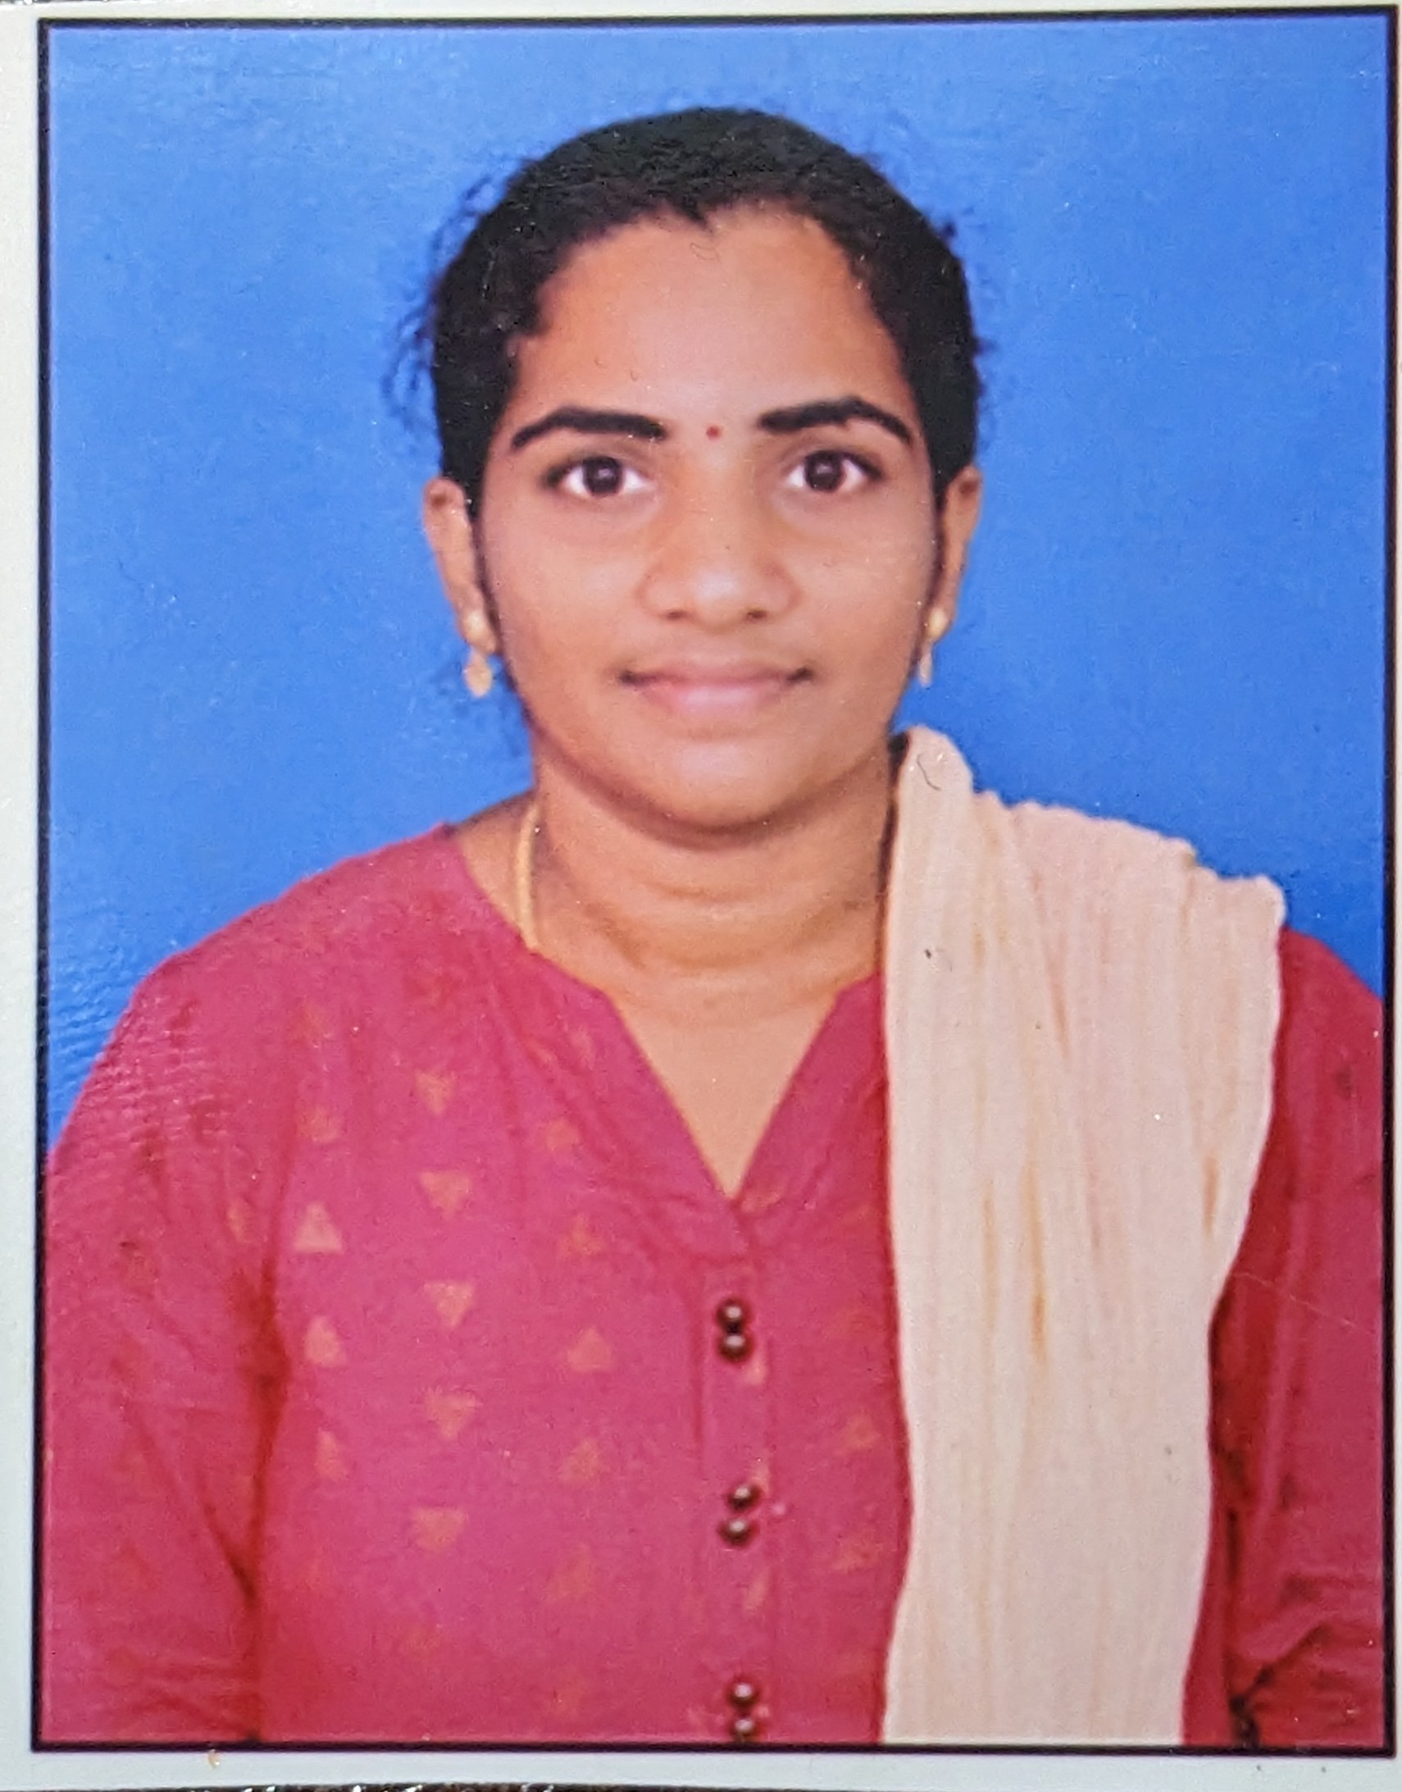
Project Tile – ChefGPT AI – Intelligent Recipe Generator & Cooking Assistant
Domain of Project –HealthCare
Student Name | Recent Passport Photo | Email ID | Mobile number [WhatsApp]
LAVANYA |  | lavanya.oct12@gmail.com | 9381480053

Slide 3
Problem Statement -
Problem Statement : ChefGPT AI – Intelligent Recipe Generator & Cooking Assistant
The Challenge
Traditional recipe applications provide static content and lack personalization. Users often face challenges such as:
Finding relevant recipes from large collections of cookbooks or notes.
Adapting recipes to dietary requirements such as vegan, keto, gluten-free, or low-calorie diets.
Identifying suitable ingredient substitutions when ingredients are unavailable.
Understanding the nutritional value of recipes.Generating organized shopping lists for meal preparation.
Receiving intelligent, conversational cooking guidance based on trusted recipe documents.

Slide 4
The Objective
The primary objective of ChefGPT AI is to develop an Agentic AI-based cooking assistant that:
Uses a RAG (Retrieval-Augmented Generation) system to retrieve relevant recipe information from uploaded documents.
Provides personalized recipe recommendations using IBM Granite Models.
Adapts recipes according to user dietary preferences and restrictions.
Suggests ingredient substitutions with reasoning and quantity conversions.
Analyzes nutritional information and offers health recommendations.
Generates categorized shopping lists.
Demonstrates multi-agent collaboration through a centralized AI orchestrator using IBM watsonx.ai Studio.

Slide 5
Proposed Solution -
Proposed Solution: The proposed solution is an intelligent, web-based cooking assistant built using Python, Flask, IBM watsonx.ai Studio, and IBM Granite Models. The application incorporates a lightweight RAG pipeline that extracts text from uploaded recipe documents, creates embeddings, stores recipe chunks in memory, and retrieves the most relevant information to answer user queries.
The system employs five specialized AI agents:
Recipe Retrieval Agent – Retrieves relevant recipes and cooking instructions using the RAG system.
Recipe Adaptation Agent – Modifies recipes based on dietary preferences.
Ingredient Substitution Agent – Recommends suitable ingredient alternatives.
Nutrition Analysis Agent – Estimates nutritional values and provides health insights.
Shopping List Agent – Generates categorized shopping lists with estimated quantities.
A Master Orchestrator Agent coordinates all agents, combines their outputs, and produces a comprehensive, personalized cooking guide. The application features a modern Flask interface with dashboards for recipe details, nutrition analysis, shopping lists, and agent workflow visualization.

Slide 6
Technology Used
Heading | Technology
Platform | IBM BOB Platform
Programming Language | Python
Web Framework | Flask
Cloud Platform | IBM Cloud
AI Platform | IBM watsonx.ai Studio
Foundation Model | IBM Granite Models (Granite 3.2 8B)
AI Architecture | Agentic AI, Multi-Agent Collaboration
Retrieval Technique | Retrieval-Augmented Generation (RAG)
Vector Database | FAISS / Chroma
Embedding Generation | IBM watsonx.ai Embeddings
Semantic Search | Vector Similarity Search
Document Processing | PyPDF2, TXT Processing
Frontend | HTML, CSS, Bootstrap 5, Jinja2
Environment Configuration | WATSONX_API_KEY, WATSONX_PROJECT_ID, WATSONX_URL

Slide 7
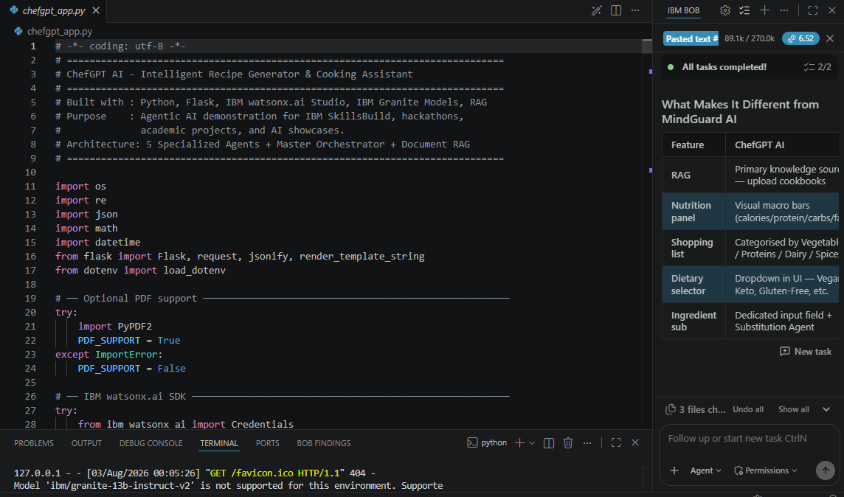
Required Files created using IBM bob -
chefgpt_app.py
chefgpt.env
chefgpt_app.py

Slide 8
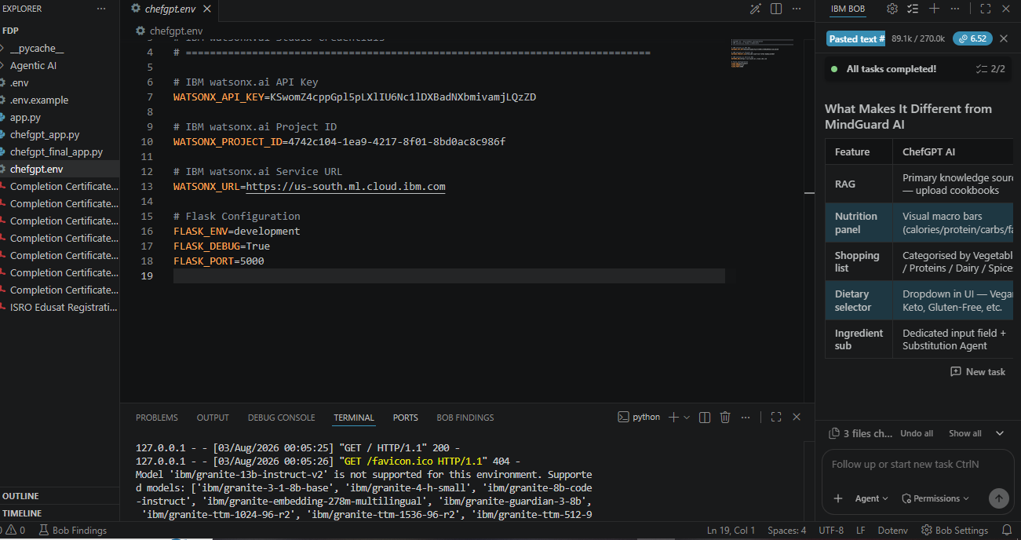
IBM Bob Screenshots:

Slide 9
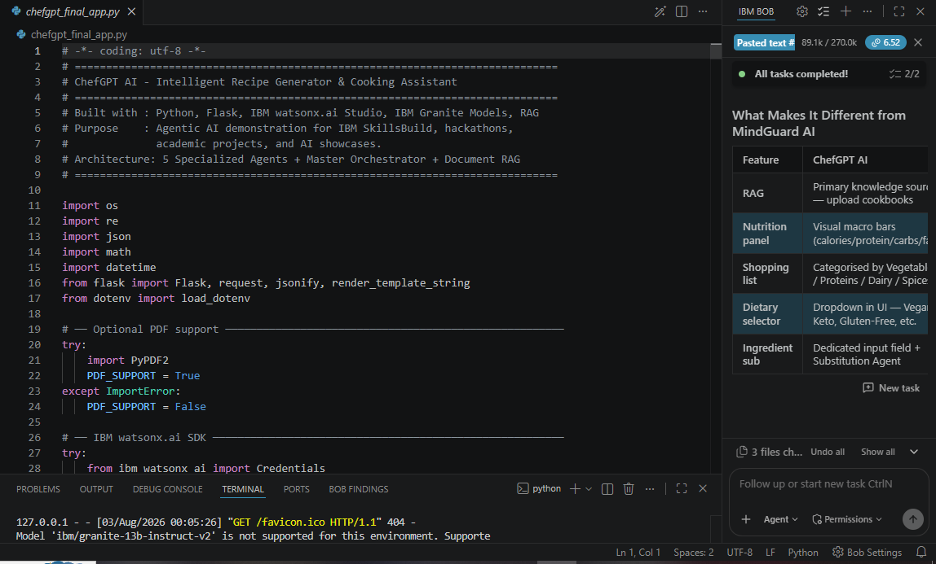

Slide 10
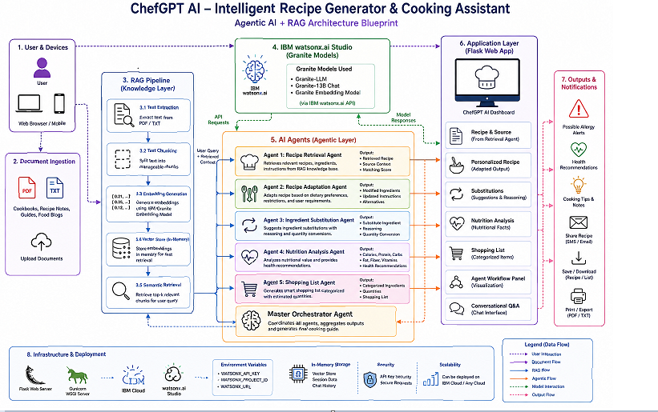
Architecture blueprint for IBM bob:

Slide 11

Role of Agentic AI in the solution
Role of Agentic AI :
Artificial Intelligence (AI) is the core of ChefGPT AI – Intelligent Recipe Generator & Cooking Assistant. Using IBM watsonx.ai Studio, IBM Granite Models, and Retrieval-Augmented Generation (RAG), the system understands user queries, retrieves relevant recipe information from uploaded documents, and generates personalized cooking recommendations.
AI also adapts recipes based on dietary preferences, suggests ingredient substitutions, analyzes nutritional values, and creates smart shopping lists.
Built with Python, Flask, and Bootstrap 5, the application delivers an intelligent, context-aware, and conversational cooking experience through a multi-agent AI architecture.

Slide 12
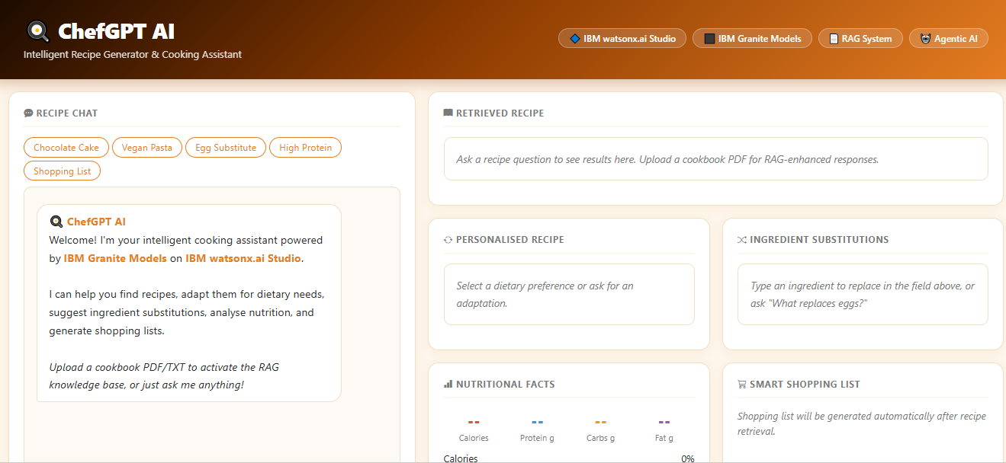
Project Output Screenshot
Please put IBM Bob output screenshots with 2-3 prompts.
You can take 2-3 more slides for each screenshot
·
·
·

Slide 13
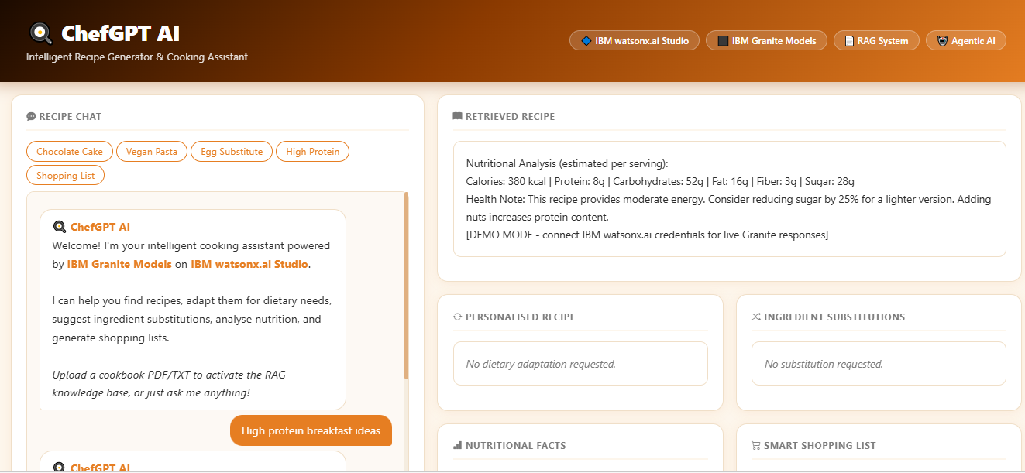
Project Output Screenshot
Please put IBM Bob output screenshots with 2-3 prompts.
You can take 2-3 more slides for each screenshot
·
·
·

Slide 14
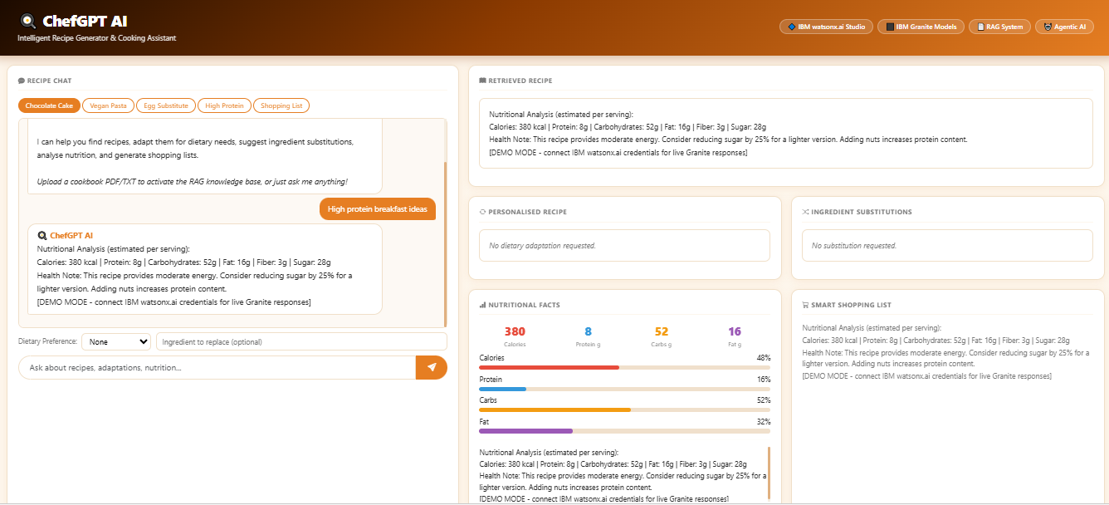

Slide 15
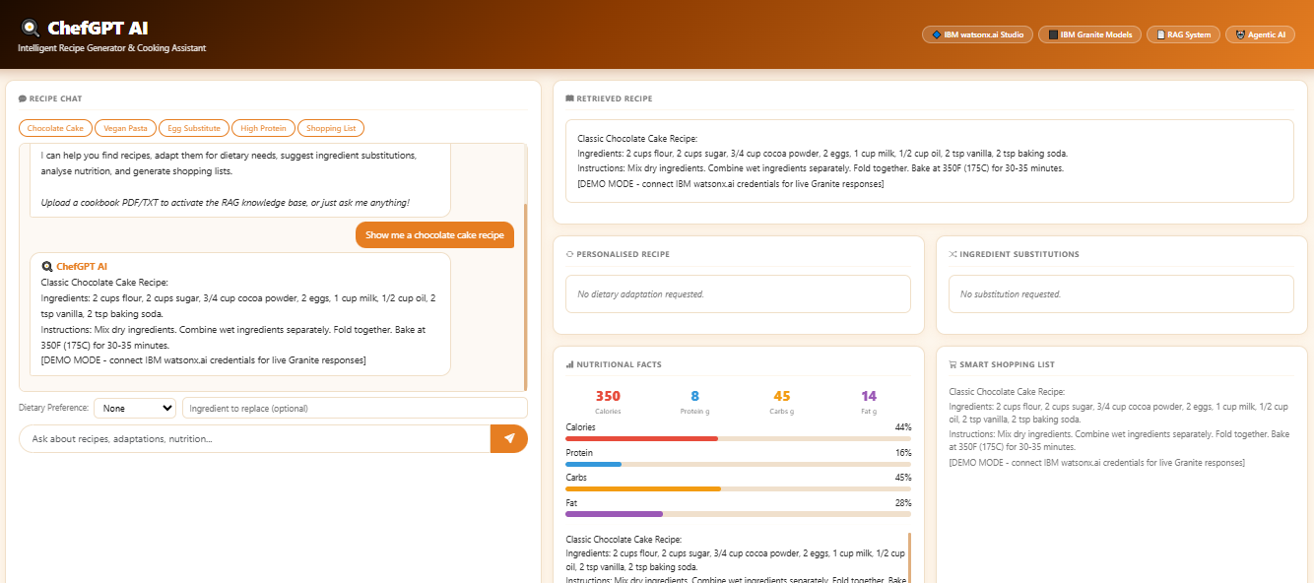

Slide 16
Novelty and Uniqueness
ChefGPT AI stands out by combining Agentic AI, IBM watsonx.ai Studio, IBM Granite Models, and Retrieval-Augmented Generation (RAG) into a single intelligent cooking assistant. Unlike traditional recipe applications that provide static recipes, ChefGPT AI retrieves information from uploaded recipe documents, understands user preferences, and generates personalized recipes in real time.
Its unique multi-agent architecture allows specialized AI agents to collaborate for recipe retrieval, recipe adaptation, ingredient substitution, nutrition analysis, and shopping list generation. The system also supports conversational Recipe Q&A, enabling users to interact naturally and receive context-aware cooking guidance. This combination of RAG, Agentic AI, and IBM Granite Models makes ChefGPT AI a smart, personalized, and interactive cooking assistant suitable for healthcare, nutrition, and modern culinary applications.

Slide 17
Git Hub Link
Please create public github repository (Enable Add README button while creating repository) with format –
Please test and Paste the working Github URL –https://github.com/lavanya1210/IBM-Project
Credly Account URL--- https://www.credly.com/users/lavanya-loya/edit/badges/credly
Make sure you have Uploaded following three files into your github repository 1) All Agent relevant files of IBM Cloud , 2) yourproblemstatement.pdf file 3) your projectpresntation.pptx file
·
·
·

Slide 18
Future Scope
Voice-Based Cooking Assistant: Integrate speech recognition and voice responses for hands-free cooking guidance.
Image-Based Ingredient Recognition: Allow users to upload food or ingredient images to generate suitable recipes.
Smart Meal Planning: Create personalized weekly meal plans based on health goals, dietary preferences, and calorie requirements.
IoT & Smart Kitchen Integration: Connect with smart kitchen appliances to automate cooking instructions and monitor cooking progress.
Multilingual Support: Enable recipe generation and conversational assistance in multiple regional and international languages.
Advanced Nutrition Tracking: Integrate with fitness and health apps to provide personalized nutrition recommendations and diet monitoring.
Cloud-Based Recipe Repository: Store and synchronize user recipes, preferences, and shopping lists across multiple devices.
Real-Time Grocery Integration: Connect with online grocery platforms for one-click ingredient ordering and delivery.
·
·
·

Slide 19
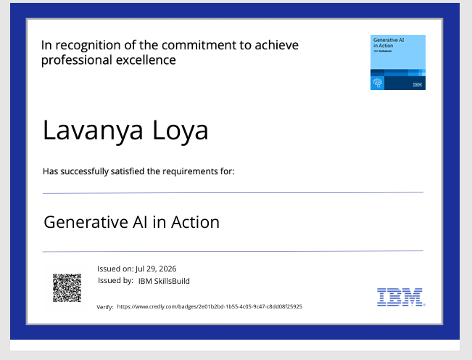
Certificates Earned:
Please add your credly certificate

Slide 20
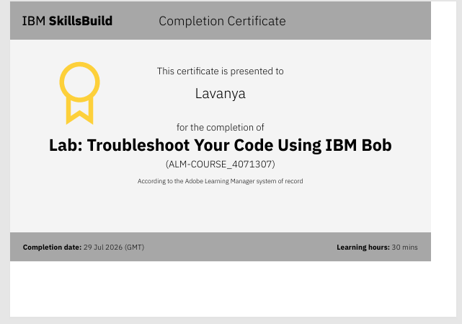
Certificates Earned:​
Add your IBM BOB Certificate

Slide 21


